Slide 1
Implement security in RESTful WebService
Notes:
https://grpc.io/

Slide 2
Objectives
Explain about Implementing security in RESTful WebService
Describe about scaling RESTful WebService (Performance of Webservice)
Describe about the Authentication and the Custom authentication: Identity, using JWT, and IdentityServer
Describe about the Authorization
Roles
Policies
Authorization handlers
Resource-based authorization
Anonymous access
Create examples to illustrate about security in the ASP.NET Web API

Slide 3
Security with RESTful Web Services - 1
As RESTful Web Services work with HTTP URL Paths, it is very important to safeguard a RESTful Web Service in the same manner as a website is secured.
Following are the best practices to be adhered to while designing a RESTful Web Service
Validation
Session Based Authentication
No Sensitive Data in the URL
Restriction on Method Execution
Validate Malformed XML/JSON
Throw generic Error Messages

Slide 4
Security with RESTful Web Services - 2
Validation − Validate all inputs on the server. Protect your server against SQL or NoSQL injection attacks.
Session Based Authentication − Use session based authentication to authenticate a user whenever a request is made to a Web Service method.
No Sensitive Data in the URL − Never use username, password or session token in a URL, these values should be passed to Web Service via the POST method.

Slide 5
Security with RESTful Web Services - 3
Restriction on Method Execution − Allow restricted use of methods like GET, POST and DELETE methods. The GET method should not be able to delete data.
Validate Malformed XML/JSON − Check for well-formed input passed to a web service method.
Throw generic Error Messages − A web service method should use HTTP error messages like 403 to show access forbidden, etc.

Slide 6
Why does security matter? - 1
Data Protection - Define clear access rights, especially for methods like DELETE (deletes a resource) and PUT (updates a resource). Those methods must be accessed by authenticated users only, and for each such call, an audit must be saved.
DOS (Denial of Service) Attacks - can render a RESTful API into a non-functional state if the right security measures are not taken. This means that REST API security is getting more and more valuable and important.
Anti-Farming In case your API does not have an Authorization/Authentication mechanism, it might lead to misuse of your API, loading the servers and the API itself, making it less responsive to others.

Slide 7
Why does security matter? - 2
Transport Layer Security (TLS) and its predecessor, Secure Sockets Layer (SSL), are cryptographic protocols that provide communications security over a computer network.
When secured by TLS, connections between a client and a server have one or more of the following properties:
The connection is private (or secure) because symmetric cryptography is used to encrypt the data transmitted.
The keys for this symmetric encryption are generated uniquely for each connection and are based on a shared secret negotiated at the start of the session.
The identity of the communicating parties can be authenticated using public-key cryptography.
The connection ensures integrity because each message transmitted includes a message integrity check using a message authentication code to prevent undetected loss or alteration of the data during transmission.

Slide 8
Describe scaling RESTful WebService
Autoscaling is the process of dynamically allocating resources to match performance requirements.
As the volume of work grows, an application may need additional resources to maintain the desired performance levels and satisfy service-level agreements (SLAs).
As demand slackens and the additional resources are no longer needed, they can be de-allocated to minimize costs.
Autoscaling takes advantage of the elasticity of cloud-hosted environments while easing management overhead. It reduces the need for an operator to continually monitor the performance of a system and make decisions about adding or removing resources.

Slide 9
Scaling application
Vertical scaling, also called scaling up and down, means changing the capacity of a resource. For example, you could move an application to a larger VM size. Vertical scaling often requires making the system temporarily unavailable while it is being redeployed. Therefore, it's less common to automate vertical scaling.
Horizontal scaling, also called scaling out and in, means adding or removing instances of a resource. The application continues running without interruption as new resources are provisioned. When the provisioning process is complete, the solution is deployed on these additional resources. If demand drops, the additional resources can be shut down cleanly and deallocated.

Slide 10
Autoscaling components
Instrumentation and monitoring systems at the application, service, and infrastructure levels. These systems capture key metrics, such as response times, queue lengths, CPU utilization, and memory usage.
Decision-making logic that evaluates these metrics against predefined thresholds or schedules, and decides whether to scale.
Components that scale the system.
Testing, monitoring, and tuning of the autoscaling strategy to ensure that it functions as expected.

Slide 11
Configure autoscaling for an Azure solution
Azure Virtual Machines autoscale via virtual machine scale sets, which manage a set of Azure virtual machines as a group.
Service Fabric also supports autoscaling through virtual machine scale sets. Every node type in a Service Fabric cluster is set up as a separate virtual machine scale set. That way, each node type can be scaled in or out independently.
Azure App Service has built-in autoscaling. Autoscale settings apply to all of the apps within an App Service.
Azure Cloud Services has built-in autoscaling at the role level.

Slide 12
Autoscaling functionality
Azure Functions differs from the previous compute options, because you don't need to configure any autoscale rules. Instead, Azure Functions automatically allocates compute power when your code is running, scaling out as necessary to handle load.
Could use Azure diagnostics and application-based metrics, along with custom code to monitor and export the application metrics.
Define custom rules based on these metrics, and use Resource Manager REST APIs to trigger autoscaling.
However, a custom solution is not simple to implement, and should be considered only if none of the previous approaches can fulfill specific requirements.

Slide 13
Implementing autoscaling patterns
Throttling pattern. This pattern describes how an application can continue to function and meet SLAs when an increase in demand places an extreme load on resources. Throttling can be used with autoscaling to prevent a system from being overwhelmed while the system scales out.
Competing Consumers pattern. This pattern describes how to implement a pool of service instances that can handle messages from any application instance. Autoscaling can be used to start and stop service instances to match the anticipated workload. This approach enables a system to process multiple messages concurrently to optimize throughput, improve scalability and availability, and balance the workload.
Monitoring and diagnostics. Instrumentation and telemetry are vital for gathering the information that can drive the autoscaling process.

Slide 14
Authentication vs. Authorization
Authentication is a process in which a user provides credentials that are then compared to those stored in an operating system, database, app or resource. If they match, users authenticate successfully, and can then perform actions that they're authorized for, during an authorization process. The authorization refers to the process that determines what a user is allowed to do.
Another way to think of authentication is to consider it as a way to enter a space, such as a server, database, app or resource, while authorization is which actions the user can perform to which objects inside that space (server, database, or app).
Notes:
https://docs.microsoft.com/en-us/aspnet/core/security/authentication/?view=aspnetcore-5.0
https://docs.microsoft.com/en-us/aspnet/core/security/authorization/introduction?view=aspnetcore-5.0

Slide 15
Overview of ASP.NET Core authentication - 1
Authentication is the process of determining a user's identity. Authorization is the process of determining whether a user has access to a resource. In ASP.NET Core, authentication is handled by the IAuthenticationService, which is used by authentication middleware. The authentication service uses registered authentication handlers to complete authentication-related actions. Examples of authentication-related actions include:
Authenticating a user.
Responding when an unauthenticated user tries to access a restricted resource.
The registered authentication handlers and their configuration options are called "schemes".

Slide 16
Overview of ASP.NET Core authentication - 2
Authentication schemes are specified by registering authentication services in Startup.ConfigureServices:
By calling a scheme-specific extension method after a call to services.AddAuthentication (such as AddJwtBearer or AddCookie, for example). These extension methods use AuthenticationBuilder.AddScheme to register schemes with appropriate settings.
Less commonly, by calling AuthenticationBuilder.AddScheme directly.
services.AddAuthentication(JwtBearerDefaults.AuthenticationScheme).AddJwtBearer(JwtBearerDefaults.AuthenticationScheme, options => Configuration.Bind("JwtSettings", options)).AddCookie(CookieAuthenticationDefaults.AuthenticationScheme, options => Configuration.Bind("CookieSettings", options));

Slide 17
Role-based authorization in ASP.NET Core
Authorization refers to the process that determines what a user is able to do. For example, an administrative user is allowed to create a document library, add documents, edit documents, and delete them. A non-administrative user working with the library is only authorized to read the documents.
Authorization is orthogonal and independent from authentication. However, authorization requires an authentication mechanism. Authentication is the process of ascertaining who a user is. Authentication may create one or more identities for the current user.

Slide 18
Authorization types - Namespaces
ASP.NET Core authorization provides a simple, declarative role and a rich policy-based model.
Authorization is expressed in requirements, and handlers evaluate a user's claims against requirements. Imperative checks can be based on simple policies or policies which evaluate both the user identity and properties of the resource that the user is attempting to access.
Authorization components, including the AuthorizeAttribute and AllowAnonymousAttribute attributes, are found in the Microsoft.AspNetCore.Authorization namespace.

Slide 19
Introduction to Identity on ASP.NET Core
ASP.NET Core Identity is the membership system for building ASP.NET Core web applications, including membership, login, and user data. ASP.NET Core Identity allows you to add login features to your application and makes it easy to customize data about the logged in user.
ASP.NET Core Identity:
Is an API that supports user interface (UI) login functionality.
Manages users, passwords, profile data, roles, claims, tokens, email confirmation, and more.
Users can create an account with the login information stored in Identity or they can use an external login provider. Supported external login providers include Facebook, Google, Microsoft Account, and Twitter.

Slide 20
What is ASP.NET Core Identity
The Identity API contains a lot of helper classes, which hides the complexities of managing the users.
It has classes to register users, authenticate them by validating their passwords, manage roles and claims etc.
It also contains the login form, registration form, password reset forms, etc.
With ASP.NET Core Identity, you need not write any code, which helps you get started quickly in App Development.

Slide 21
What ASP.NET Core Identity System can do
Database schema for storing users, claims & Roles.
UI for logging in, creating, and managing users
Create/Modify/Delete User
Create/Modify/Delete User Claims
Password validation and rules.
Password Hashing
User account lockout
Generating password-reset tokens.
Multi Factor Authentication
Managing External Identity providers (for example Facebook, Google, Twitter).

Slide 22
ASP.NET Core Identity Architecture - 1
ASP.NET Core Identity consists of two main category of classes. They are Managers and Stores.
Managers
The Managers manage the identity related data such as creating a user, adding roles, etc. It has classes like UserManager, RoleManager, SignInManager, etc.
User Manager contains the methods to create, delete, update the users. It uses the stores to persist the data to the database
SignIn Manager is responsible for login and log out the user from the application. It contains the methods like SignInAsync, SignOutAsync etc. On Sign In, it creates a new ClaimsPrincipal from the User data. It sets the HttpContext.User property to the new ClaimsPrincipal. Then it serializes the principal, encrypts it, and stores it as a cookie.

Slide 23
ASP.NET Core Identity Architecture - 2
Stores persists the users, roles, etc. to the data source.
The ASP.NET Core Identity API uses the Entity Framework Core to store the user information in SQL Server Database. But you can change it to use a different database or ORM
The Identity system decouples the Stores & Managers from each other. Hence, we can easily change the database providers without disrupting the entire application

Slide 24
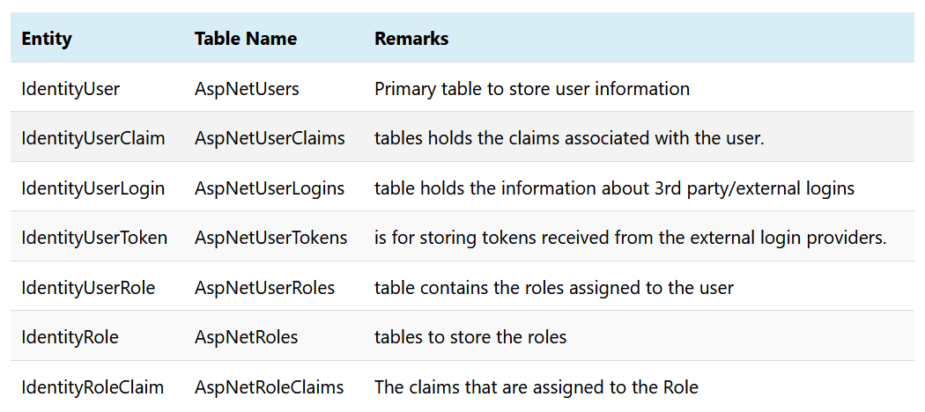
ASP.NET Core Identity Architecture - 3

Slide 25
Authentication Middleware
UseAuthentication() registers the Authentication Middleware.
The main purpose of the Authentication Middleware is to update the HttpContext.User Property with the ClaimsPrincipal. To do that, it uses the default Authentication Handler and invokes the AuthenticateAsync() method. As mentioned earlier, The AuthenticateAsync() method of the Authentication Handler must return the ClaimsPrincipal.s.

Slide 26
How Authentication and Authorization Works
Unauthenticated Request
1. The Request reaches the Authentication Middleware.
2. The Authentication Middleware checks to see if a proper credential present in the request. It will use the default authentication handler to do that. It could be a Cookies handler/ JWT handler. Since it does not find any credential, it will set the User Property to an anonymous user.
3. Authorization Middleware (UseAuthorization()) checks to see if the destination page needs Authorization.
If No then the user is allowed to visit the Page
If Yes it invokes the ChallengeAsync() on the Authentication Handler. It redirects the user to Login Page

Slide 27
How Authentication and Authorization Works
Signing In
1. User Presents the Id & Password in the Login Form and clicks on the Login button
2. The Request hits the sign-in endpoint after going through the Authentication & Authorization Middlewares. Hence the sign-in endpoint must have Allowanonymous decorator else request will never reach it.
3. Users id & password is validated against the database
4. If the Cookie Authentication handler is used
Creates a ClaimsPrincipal of the user with the claims of the User
Use the HttpContext.SignInAsync to creates an encrypted cookie and adds it to the current response.
The Response is returned to the Browser
The Browser stores the cookie

Slide 28
How Authentication and Authorization Works
Signing In (cont.)
5. If the JWT Bearer Authentication handler is used
Creates a JWT Token of the user with the claims of the User
JWT Token is sent to the user as a response
The Users reads the token and stores it in Local storage, session storage, or even in cookies
6. The user is now authenticated

Slide 29
How Authentication and Authorization Works
Authenticating the Subsequent Requests
1. The user makes a request to protect the page.
2. If you are using cookie authentication, then you do not have to do anything. The Browser will automatically include the cookie with every request. But in the case of the JWT token, you need to include the token in Authorization header.
3. The Request reaches the Authentication Middleware. It will use the default Authenticate handler to read the cookie / JWT Token and constructs the ClaimsIdentity and updates the HttpContext.User property with it
4. The Authorization Middleware sees that the user is authenticated by inspecting the HttpContext.User property and allows access to it.

Slide 30
Demo ASP.NET Core with Authentication

Slide 31
Create a Web app with authentication - 1
Create an ASP.NET Core Web Application project with Individual User Accounts.
Select File > New > Project > Select ASP.NET Core Web Application. Then select Change Authentication.
Select Idividual User Accounts under the Authentication Type Option. Most of the Identity related services and UI forms like Register, Login & Logout are automatically created for us.

Slide 32
Create a Web app with authentication - 2
The Two important Identity services are User Manager and Sign In Manager.
The UserManager is a concrete class that manages the user. This Class Creates, Updates, and Deletes the Users. It has methods to find a user by User ID, User Name, and email. UserManager also provides the functionality for adding Claims, removing Claims, add and removing roles, etc. It also generates password hash, Validates Users etc.
SignInManager is a concrete class which handles the user sign in from the application. The SignInManager is responsible for Authenticating a user, i .e signing in and signing out a user. It issues the authentication cookie to the user.

Slide 33
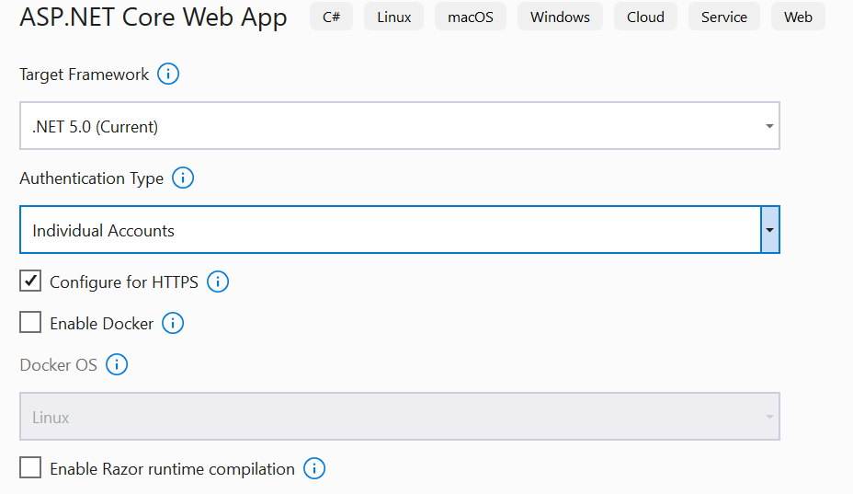
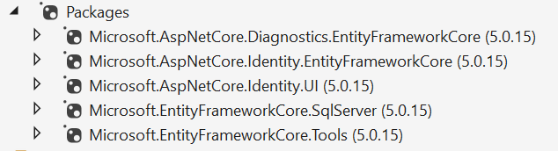
Create a Web app with authentication - 3
Install packages
dotnet add package Microsoft.AspNetCore.Identity
dotnet add package Microsoft.AspNetCore.Identity.EntityFrameworkCore
dotnet add package Microsoft.EntityFrameworkCore.SqlServer
dotnet add package Microsoft.EntityFrameworkCore.Tools
dotnet add package Microsoft.EntityFrameworkCore.Design
Add Connection String in appsettings.json
Server=(local);Database=ASPNetCoreIdentity;Uid=sa;Password=1234567890; "

Slide 34
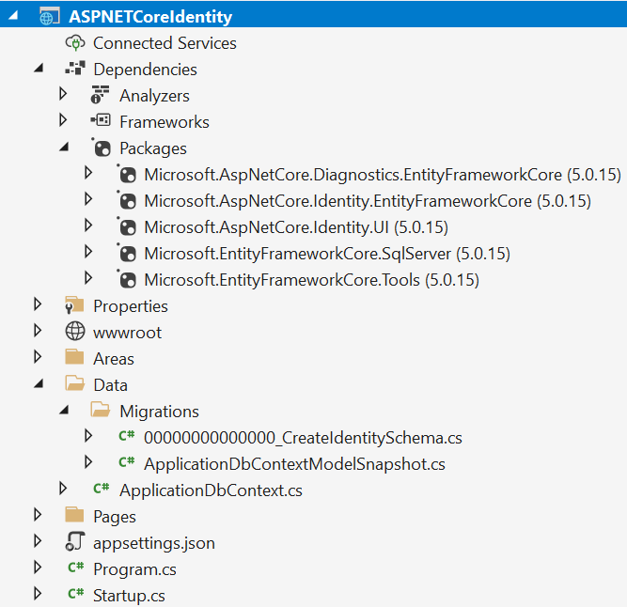
Create a Web app with authentication - 4
The Microsoft.AspNetCore.Identity namespace contains the Entity Models of the Identity API. Identity Models
IdentityRole
IdentityRoleClaim
IdentityUser
IdentityUserClaim
IdentityUserLogin
IdentityUserRole
IdentityUserToken

Slide 35
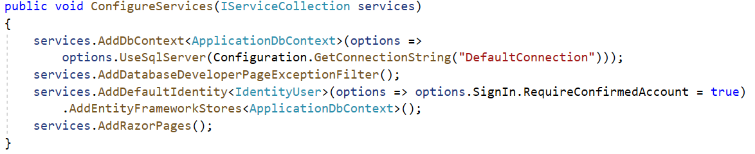
Create a Web app with authentication - 5
The ConfigureServices method of the Startup.cs class configures the identity and ApplicationDbContext related services
AddDefaultIdentity configures the Identity Services.
The AddEntityFrameworkStores configures the Identity to use the Entity Framework Core. We also need to specify the type of the Context that we are going to use to the Store

Slide 36
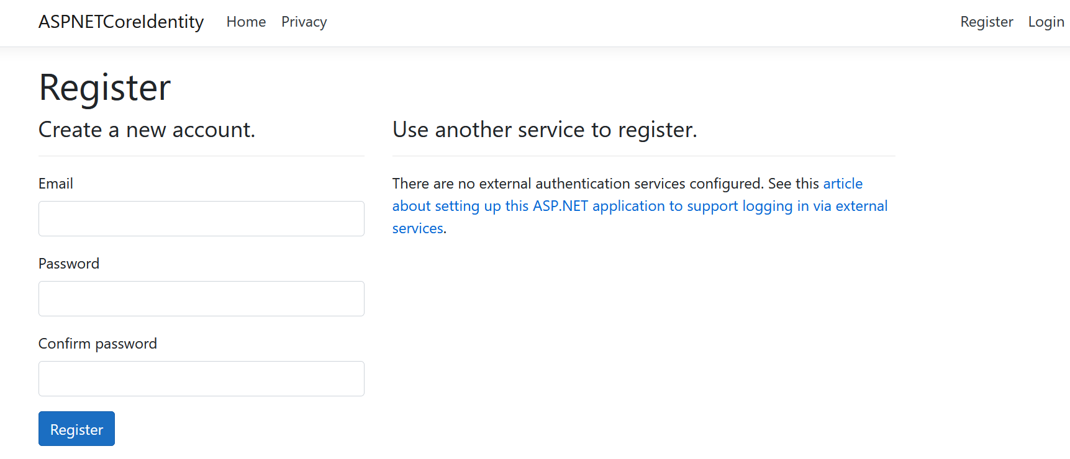
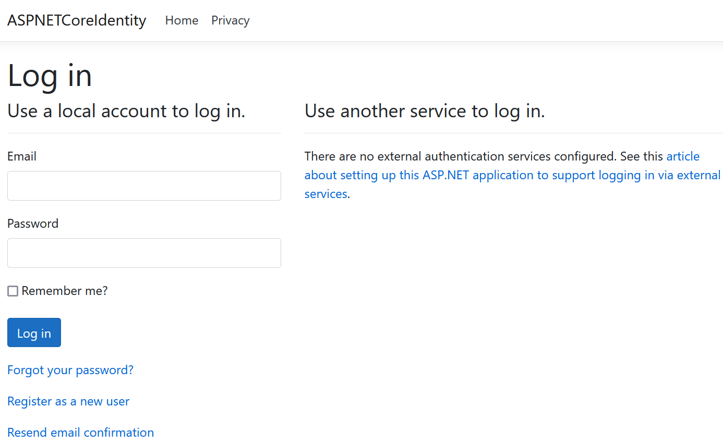
Create a Web app with authentication - 5

Slide 37
JWT Authentication in ASP.NET Core Web API
The JWT Authentication mechanism issues a digitally signed Bearer token to the Authenticated clients.
The clients then need to present the token on every request in the Request header to gain access to the Protected Resources.
The JWT Authentication typically used in Web API (REST API)
JSON Web Token (JWT) contains the claims of the user as name-value pair in the JSON Format. The issuer then digitally signs it using a private key (secret) before issuing it to the users.

Slide 38
JWT Token (Access Token) - 1
JSON Web Token (JWT or Access Token) consists of three parts. Header, Payload and Signature
The Header contains information about the algorithm that the issuer uses to generate the Token. The header typically consists of two parts: the type of the token, which is JWT, and the signing algorithm being used, such as HMAC SHA256 or RSA.
The Payload contains the claims of the User. The second part of the token is the payload, which contains the claims. Claims are statements about an entity (typically, the user) and additional data. There are three types of claims: registered, public, and private claims.

Slide 39
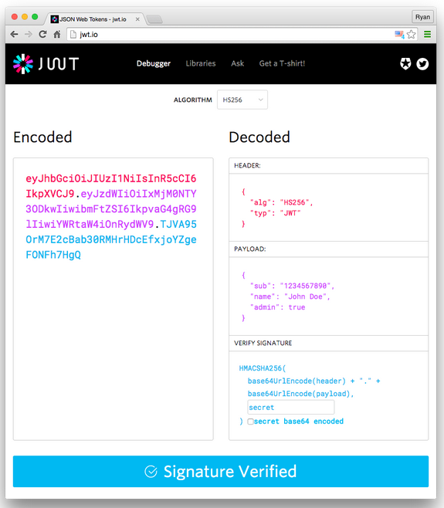
JWT Token (Access Token) - 2
Signature
To create the signature part you have to take the encoded header, the encoded payload, a secret, the algorithm specified in the header, and sign that.

Slide 40
Why should we use JSON Web Tokens?
As JSON is less verbose than XML, when it is encoded its size is also smaller, making JWT more compact than SAML. This makes JWT a good choice to be passed in HTML and HTTP environments.
Security-wise, SWT can only be symmetrically signed by a shared secret using the HMAC algorithm.
JSON parsers are common in most programming languages because they map directly to objects. Conversely, XML doesn't have a natural document-to-object mapping. This makes it easier to work with JWT than SAML assertions.
Regarding usage, JWT is used at Internet scale. This highlights the ease of client-side processing of the JSON Web token on multiple platforms, especially mobile.

Slide 41
Demo ASP.NET Core with JWT

Slide 42
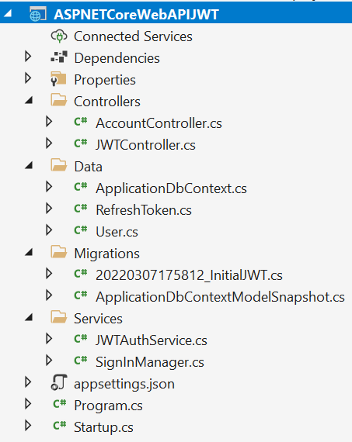
Testing JWT Authentication in ASP.NET Core
Implement the JWT Authentication in an ASP.NET Core Web API Project.
To test the API we will be making use of Postman.
Create ASP.NET Core Web API.

Slide 43
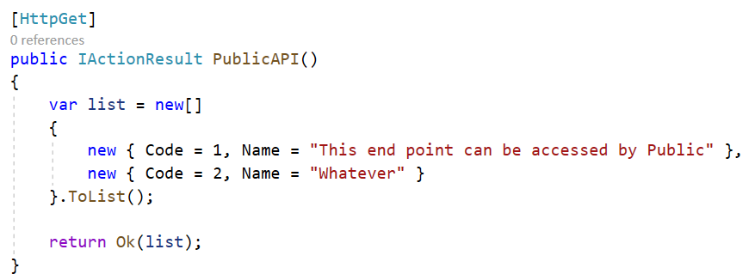
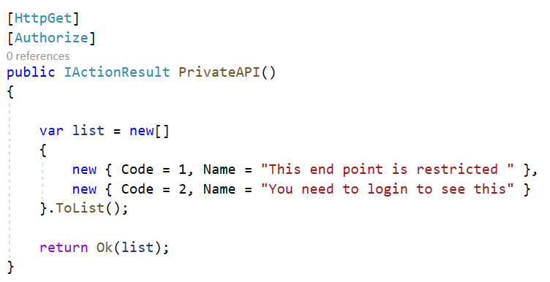
Testing JWT Authentication in ASP.NET Core
Create API Controller with 2 action methods: public and private.

Slide 44
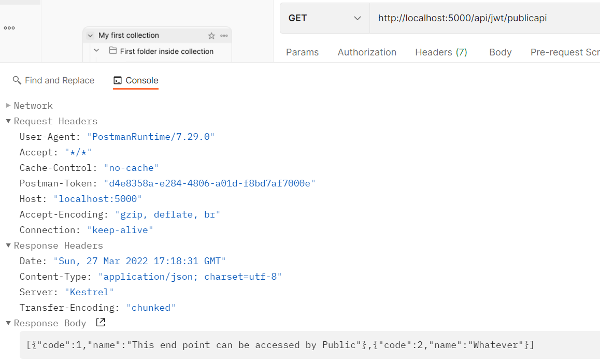
Testing JWT Authentication in ASP.NET Core

Slide 45
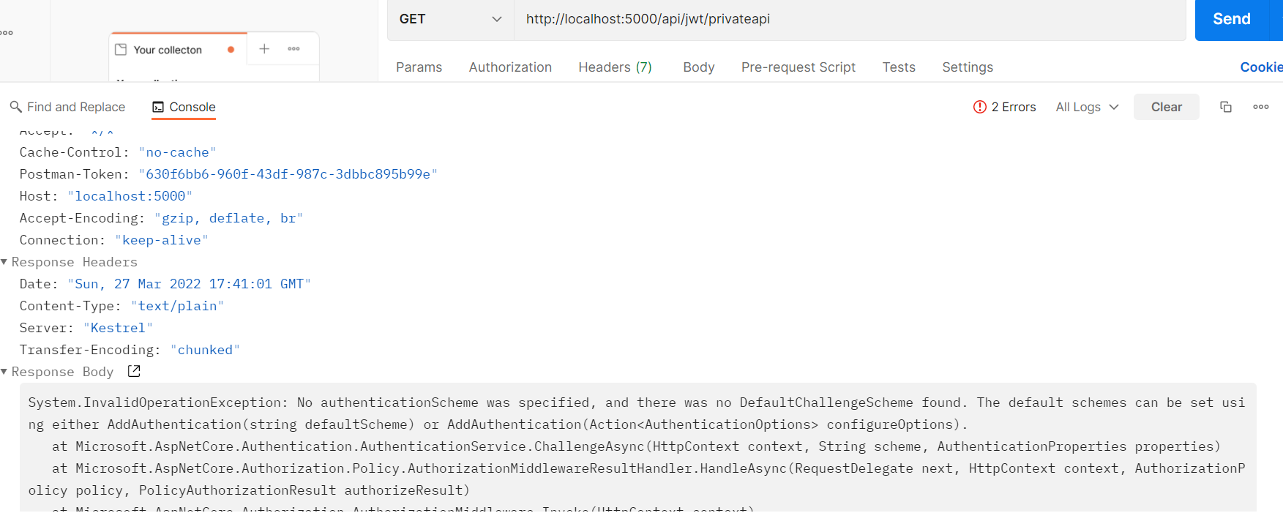
Testing JWT Authentication in ASP.NET Core

Slide 46
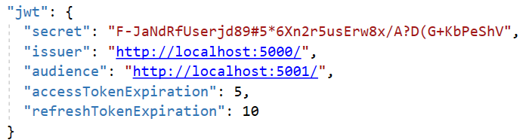
In appsettings.json, add the configuration values to create an access token and refresh token.
Create JWT Token
Create Refresh Token
Create Signing In, Adding Claims
Registering the Authentication Services
Authentication Middleware
Login and Refresh token End Points

Slide 47
Testing the JWT Bearer Authentication
First test the Request will hit the api/account/login end point logins the user and returns Access & Refresh Token
URL : https://localhost:<PortNo>/api/account/login
Type : Post
Headers : Content-Type = application/json
Body : Type Raw
{ "username": "test@gmail.com", "password": "1234567890"}
Then
URL : https://localhost:<PortNo>/api/jwt/privateapi
Type : Get
Authorisation Type : Bearer
Token : Copy the token from the login request

Slide 48
Testing the JWT Bearer Authentication
Change the token and send the request again and you will get the 401 Unauthorized response
To test the Refresh Token create a new Request. Change the Access token & Refresh token
URL : https://localhost:<PortNo>/api/account/refreshtoken
Type : POST
Header : Content-Type = application/json
Body : Raw
{
"accessToken":"Copy Access token here",
"refreshToken":"Copy refresh token here"
}

Slide 49
Summary
The concepts were introduced:
Explain about Implementing security in RESTful WebService
Describe about scaling RESTful WebService (Performance of Webservice)
Describe about the Authentication and the Custom authentication: Identity, using JWT, and IdentityServer
Describe about the Authorization
Create examples to illustrate about security in the ASP.NET Core Web Application and ASP.NET Core Web API

